Slide 1


L’Aquila: A Story of Resilience
Daniela D’Andrea, CEO Swiss Re Italy

Slide 2
Monday.
6 April 2009.
3.31 a.m.
L’Aquila is quietly asleep.

Slide 3
3.32 a.m.
Earthquake.
L’Aquila
is no more

Slide 4
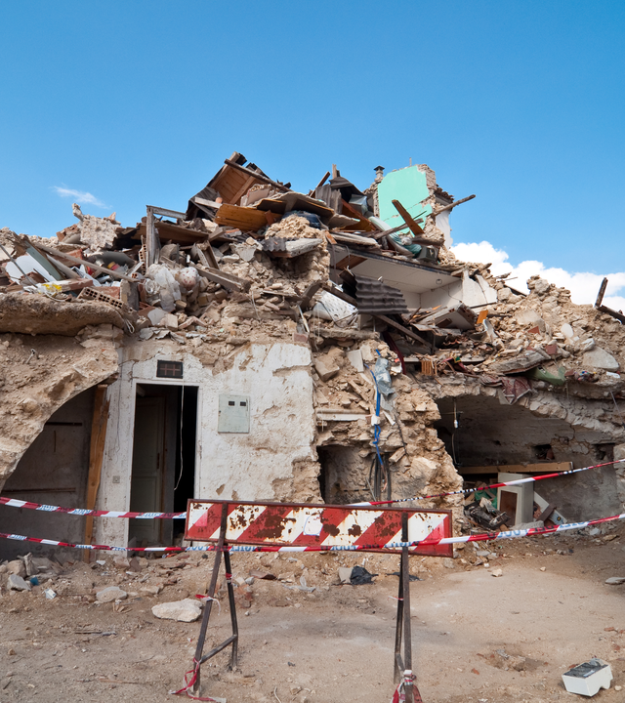
309 dead
The Aftermath
1 600 injured
80 000 displaced
€ 10 bn in damages

Slide 5
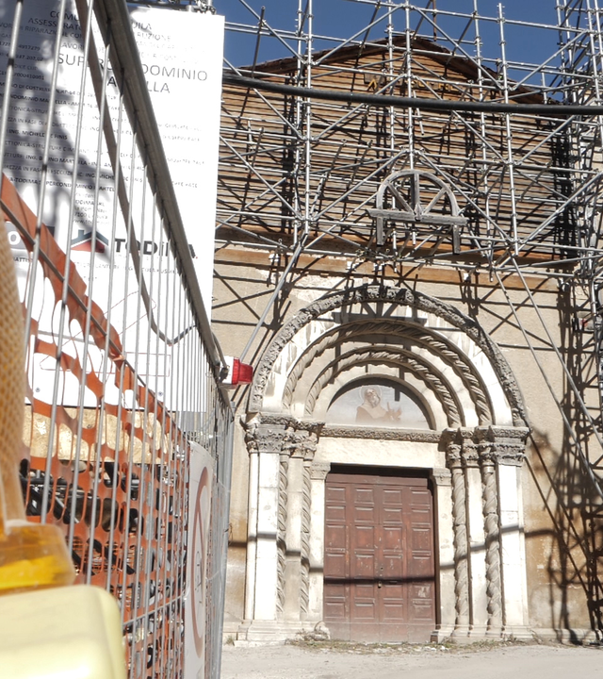
Ten years later…
Ongoing
reconstruction efforts
Uninhabited
historical city center
A changed
community

Slide 6
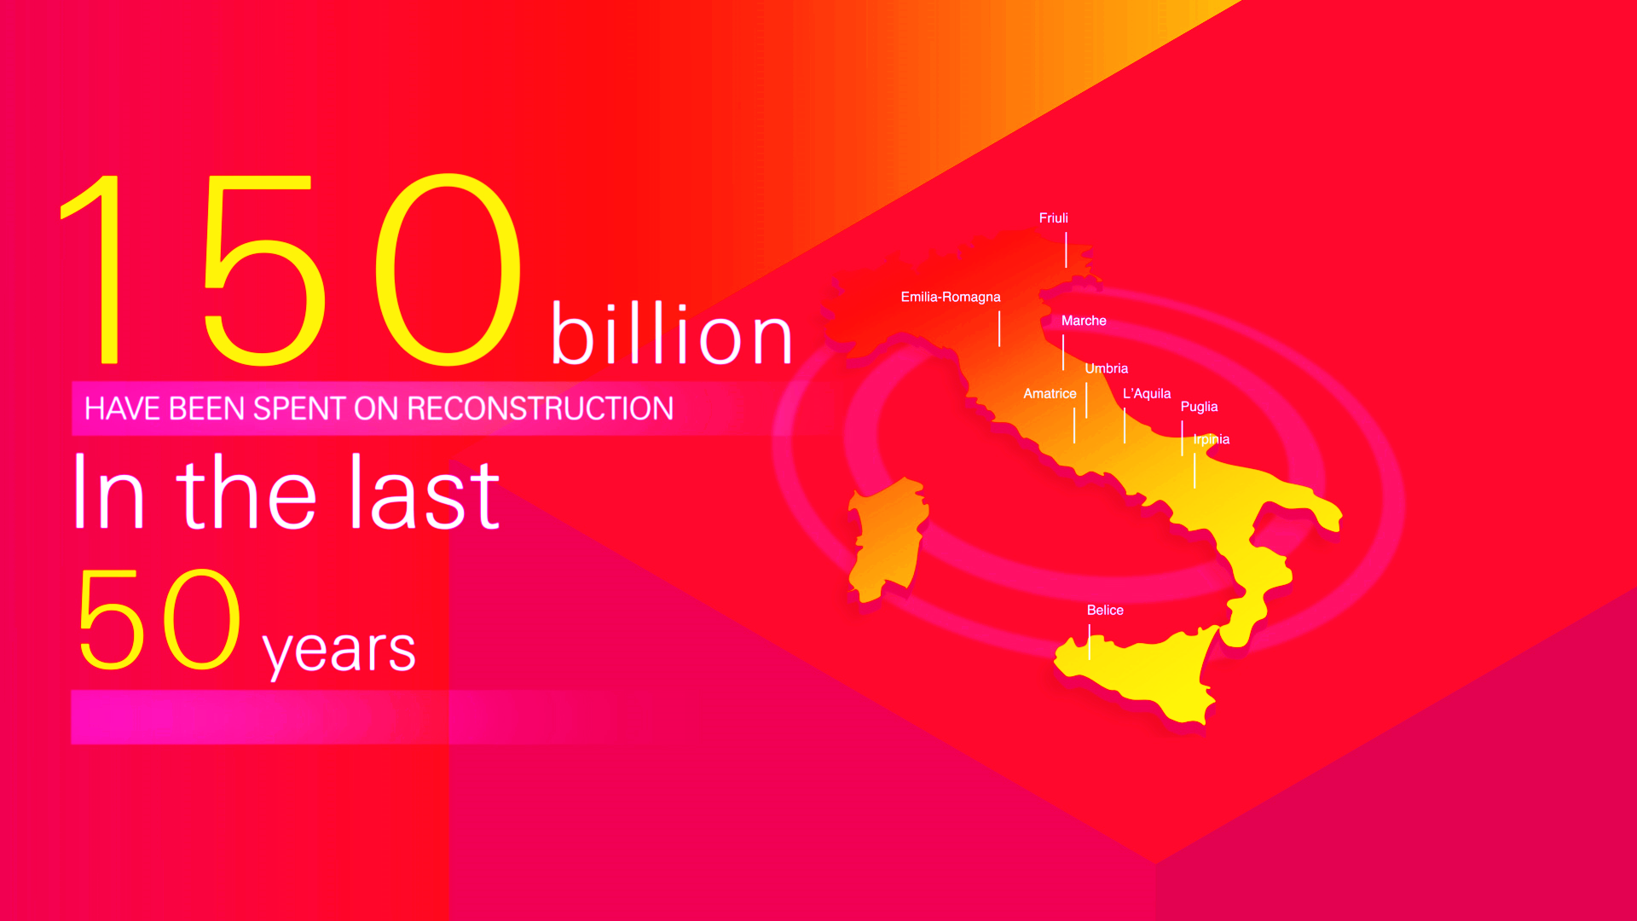

Italy
a country of
fragile
beauty
15
17
3
6
4
34
8

Slide 7
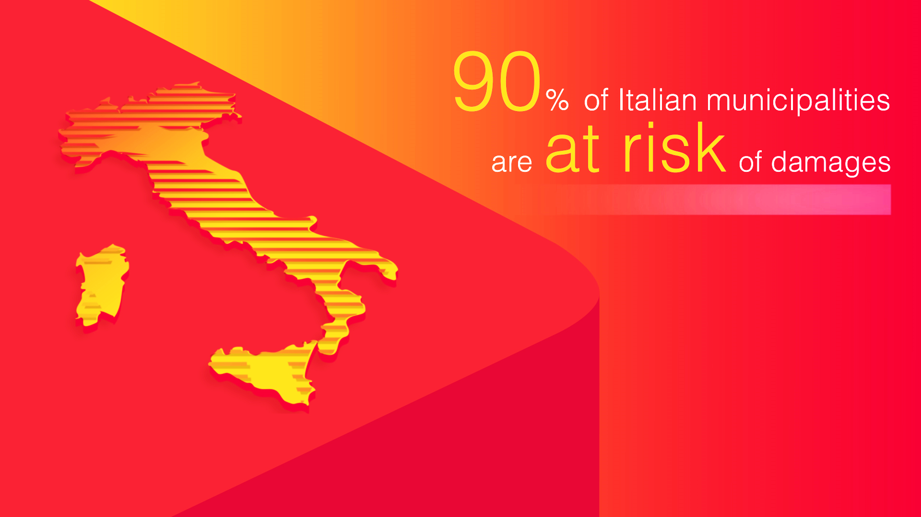

Slide 8
Insurance: A preventive step for faster recovery
Insurance
More secure and swift recovery
Funds available within hours after a catastrophe
Direct support

Slide 9
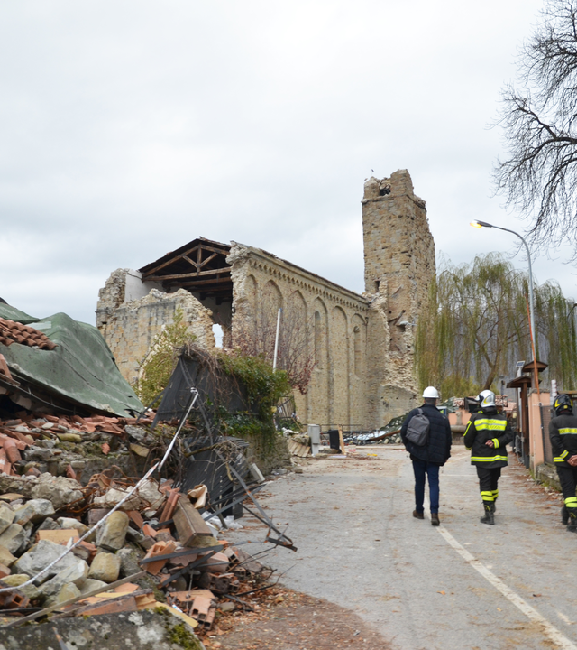
Governmental incentive towards resilience
Catastrophe insurance
tax incentives for uptake
Tax incentives
retrofitting actions against earthquake vulnerability
Private sector support
resilience building

Slide 10
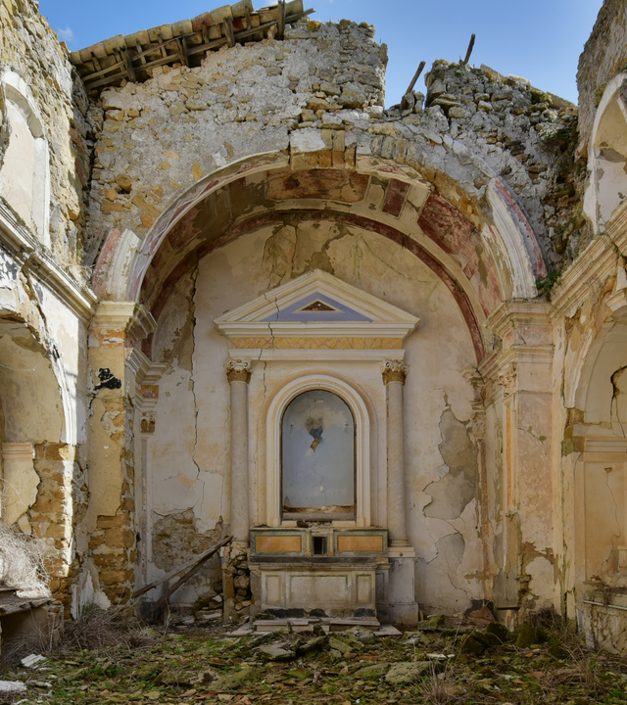
Together against natural catastrophes
Project Sant’Emidio
Signed by Cattolica Assicurazioni and the Italian Bishops Conference
26,000 Italian parishes and their social areas now protected against Nat Cat damages
Project Amici + Casa
New collective insurance product dedicated to private dwellings
Preventive monitoring to strengthen personal bonds and protect households

Slide 11
Earthquakes in Italy are insurable
Learn more…
Daniela D'Andrea, CEO Swiss Re Italy
Swiss Re
Via di San Basilio, 72, 00187 ROME, Italy
Direct: +39 06 3239 3762 | Fax: +39 06 3239 3772 | Mobile: +39 335 186 4949
E-mail: Daniela_DAndrea@swissre.com
www.swissre.com

