Slide 1
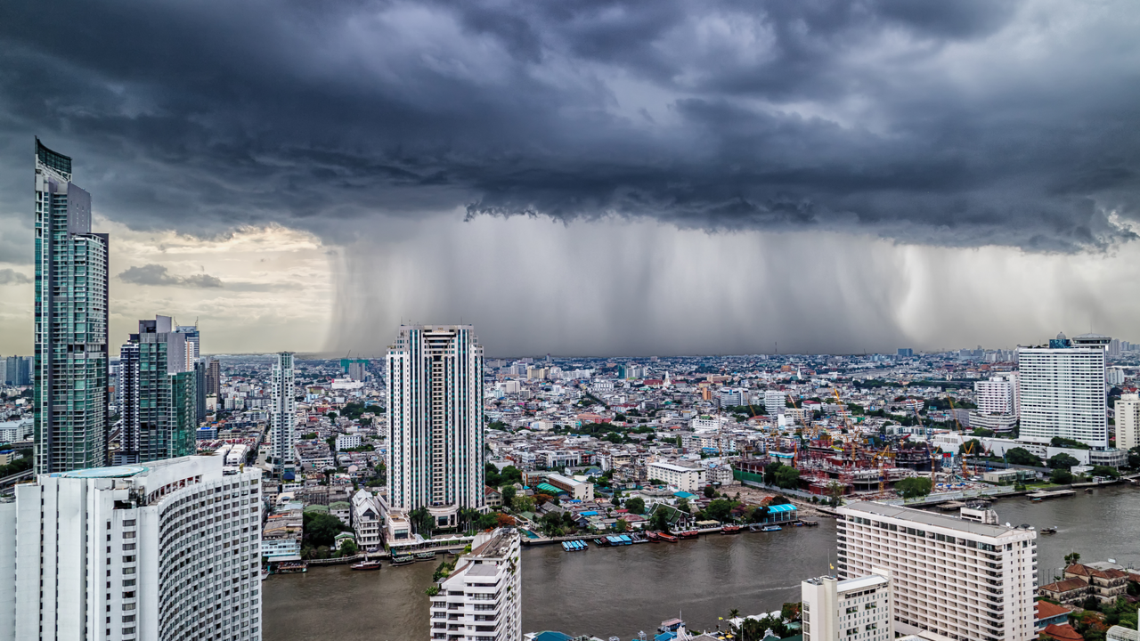

sigma 2/2019
Natural catastrophes and man-made disasters in 2018:
“secondary” perils on the frontline
Lucia Bevere, Swiss Re Institute

Slide 2
Table of Contents / Agenda
Once you have finished creating the slides for your presentation you can go to:
„Swiss Re“ > „Tools“ > „Table of Contents“ to adjust this slide.

Slide 3

2018 insured losses: 4th highest on record
2018 disaster losses
Economic losses
USD 165bn
Small to mid-sized events contributed to majority of insured losses (e.g. California Wildfires, Severe Thunderstorms, Japan Flood and Typhoons, US Hurricanes)
Tropical cyclone-induced flooding (e.g. Hurricane Florence-induced flooding)
Heat-related perils significantly contributed to the losses, adding to the discussion on the role of climate change
Insured losses
USD 85bn
Many of these small to medium-severity events are loosely known as “secondary perils” in the re/insurance industry
2017 & 2018 insured losses
USD 235

Slide 4
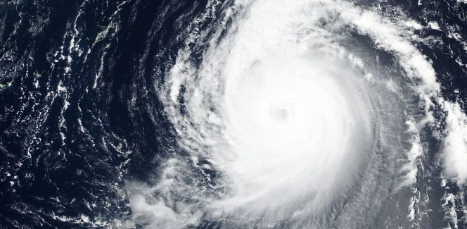
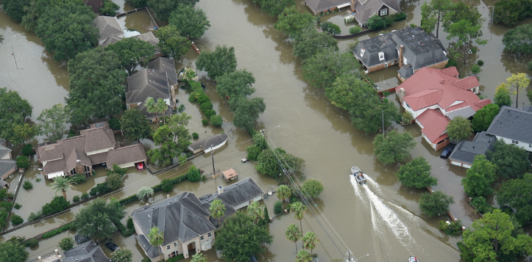
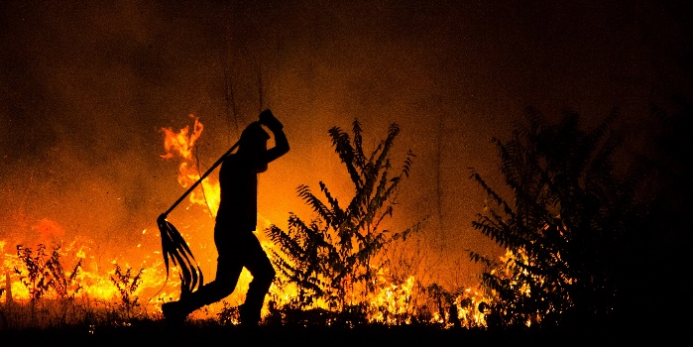
Secondary Perils come in two forms, many times in unpredictable ways
Primary Perils
(i.e., Peak Perils)
Secondary Perils as
Secondary effects of Primary Perils
Independent high-frequency perils
Hurricane Maria
Hurricane Harvey-induced flooding
California wildfires
Tropical cyclones, earthquakes, and EU winter storms
High loss potential and well modelled
Tropical cyclone-induced precipitation, storm surge, liquefaction, tsunami, fire following earthquake
Not always well captured in Primary Perils modelling
Low to medium severity perils e.g., severe thunderstorms, river/flash floods, wildfires, droughts, snow/ice storms
Lack of robust and efficient tools, gap in model coverage worldwide

Slide 5
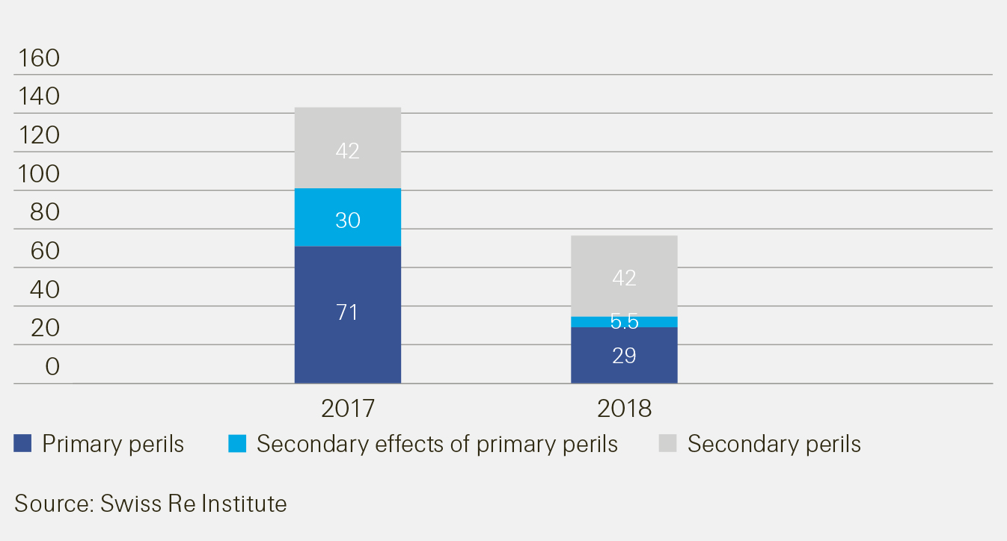
Over 50% of Nat Cat losses came from Secondary Perils in 2017 and 2018
USD billion at 2018 prices
CA Wildfires
US Severe Thunderstorms
US Floods
Since 1990, losses from secondary perils (including secondary effects) increased annually by 7.4% compared to 5.7% of the primary perils
CA Wildfires
US Severe Thunderstorms
Japan Flood, Sydney Hailstorm
Hurricane Harvey- induced flooding
Hurricane Florence-induced flooding
HIM
Typhoon Jebi & Trami
Hurricane Michael & Florence

Slide 6
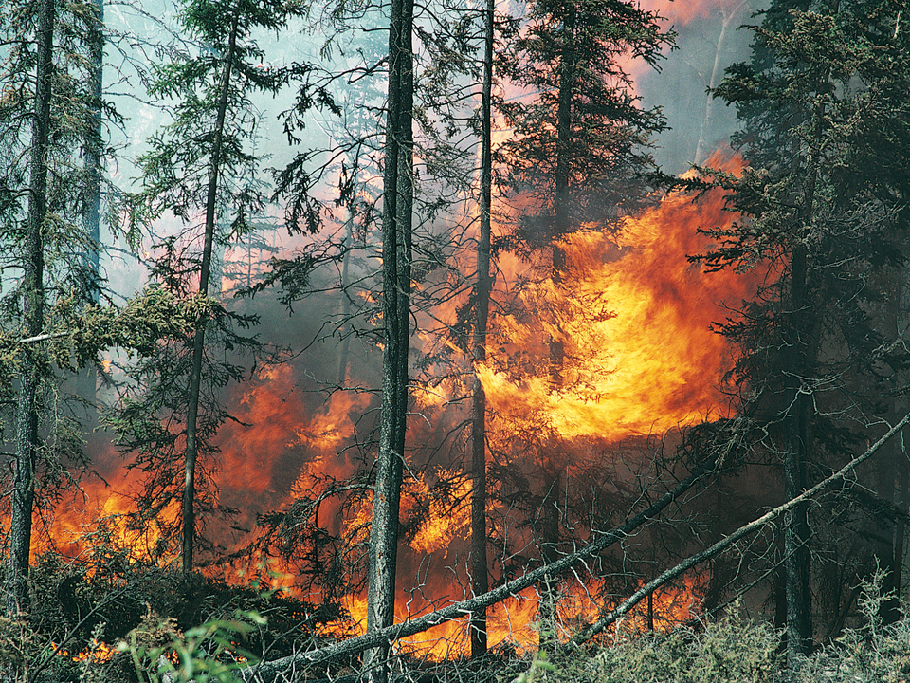
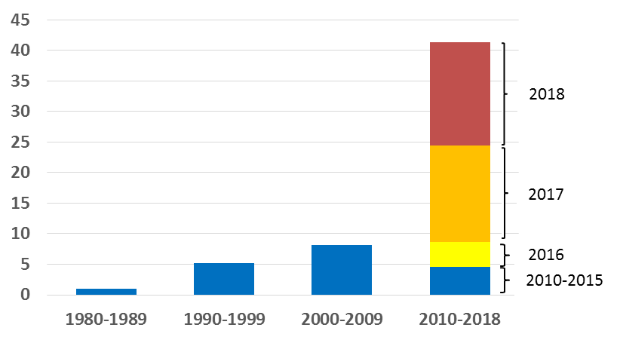
  Record high wildfire losses, yet again
  Rising exposure in the wildland-urban interface (WUI), region where developed structures are adjacent to or within undeveloped natural areas
  Increasing accumulation of fuels due to changes in timber harvesting, infestation, etc.
  Wildfire seasons (defined as the time between the first discovery and last control of a wildfire) are getting longer
  Wildfires are getting bigger (>400 hectares)
Global insured losses from wildfires (USD billion, in 2018 prices)

Slide 7
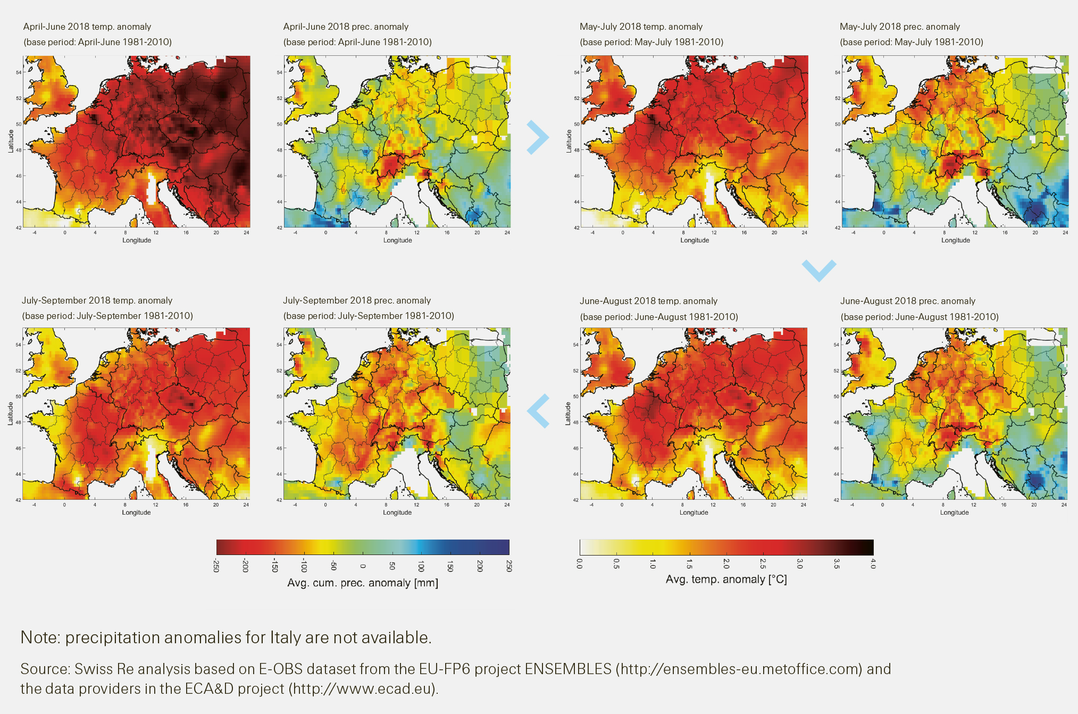
The 2018 summer was one of the warmest and driest in northern Europe…
Development of temperature and precipitation anomalies in April-September 2018 in Europe, relative to a 1981‒2010 base period

Slide 8
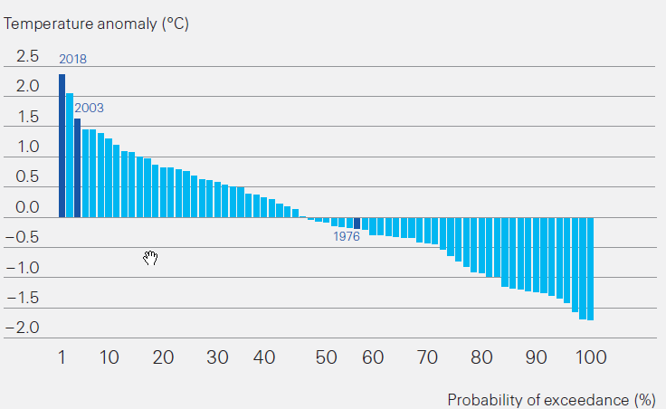
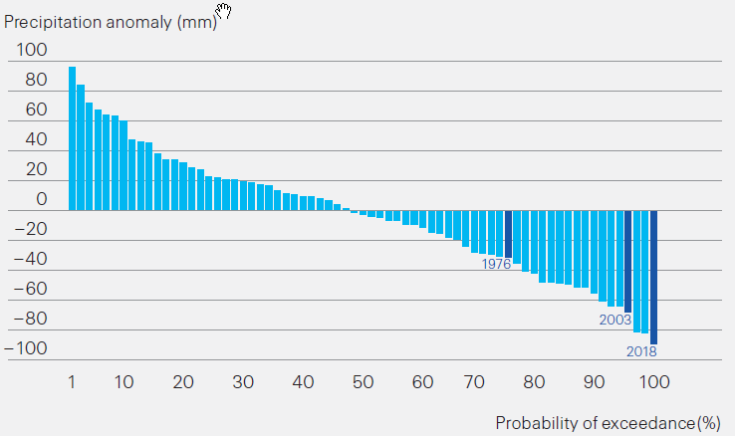
…leading to an exceptional drought
Economic losses in agriculture across Germany, France and Poland were close to EUR 6 billion (USD 6.9 billion), of which only EUR 269mn (USD 308mn) was insured
Total ex-post government support close to USD 1.4bn
Drought insurance is possible
Technology supports the development of new insurance products (global satellite data coverage)
Precipitation and temperature deviations for northern Europe, July to September, compared with the average values for the period 1950-2018

Slide 9
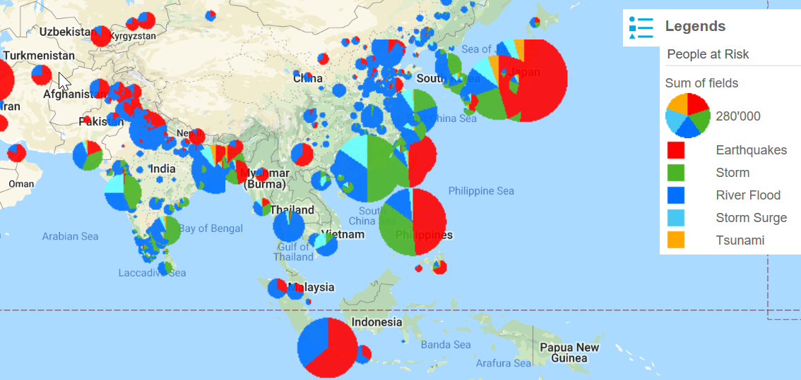
What could be the driving factors for rising Secondary Perils losses?
Rapid Urbanization
Climate Change
High Confidence Low Confidence
People at Risk
Heat
Waves
Winter
storms
Sea Level
Rise
Hurricane
Heavy
Rain
Tornadoes
/Hail
  Concentration of risks (hot spots), e.g., 2011 Thailand Flood, 2017 Hurricane Harvey flooding in Houston
  55% to 68% of urban populations by 2050 (i.e., another 2.5bn people)
  Relatively a strong and direct link between sea level rise/precipitation and temperature rise
  Example, every 1ºC change leads to 7% increase in moisture holding capacity in atmosphere

Slide 10
Secondary Perils on the frontline
Secondary perils are computationally intensive to model
Secondary perils make an important risk pool to access
Can happen anywhere
Highly localized
Can be influenced by unpredictable human intervention
Short-term time horizon of secondary perils can be an opportunity to develop insurance culture in new markets
Industry has demand for secondary perils/stop loss covers
Secondary Perils must get the “primary” attention to develop robust risk tools which enable re/insurance solutions to tap this growing risk

Slide 13
Legal notice
©2019 Swiss Re. All rights reserved. You are not permitted to create any modifications
or derivative works of this presentation or to use it for commercial or other public purposes
without the prior written permission of Swiss Re.
The information and opinions contained in the presentation are provided as at the date of
the presentation and are subject to change without notice. Although the information used
was taken from reliable sources, Swiss Re does not accept any responsibility for the accuracy
or comprehensiveness of the details given. All liability for the accuracy and completeness
thereof or for any damage or loss resulting from the use of the information contained in this
presentation is expressly excluded. Under no circumstances shall Swiss Re or its Group
companies be liable for any financial or consequential loss relating to this presentation.

