Slide 1
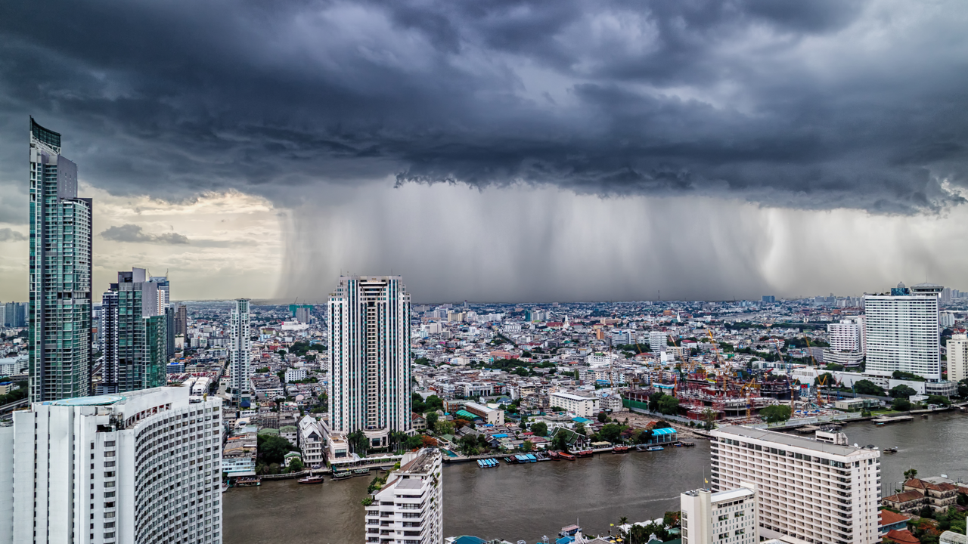
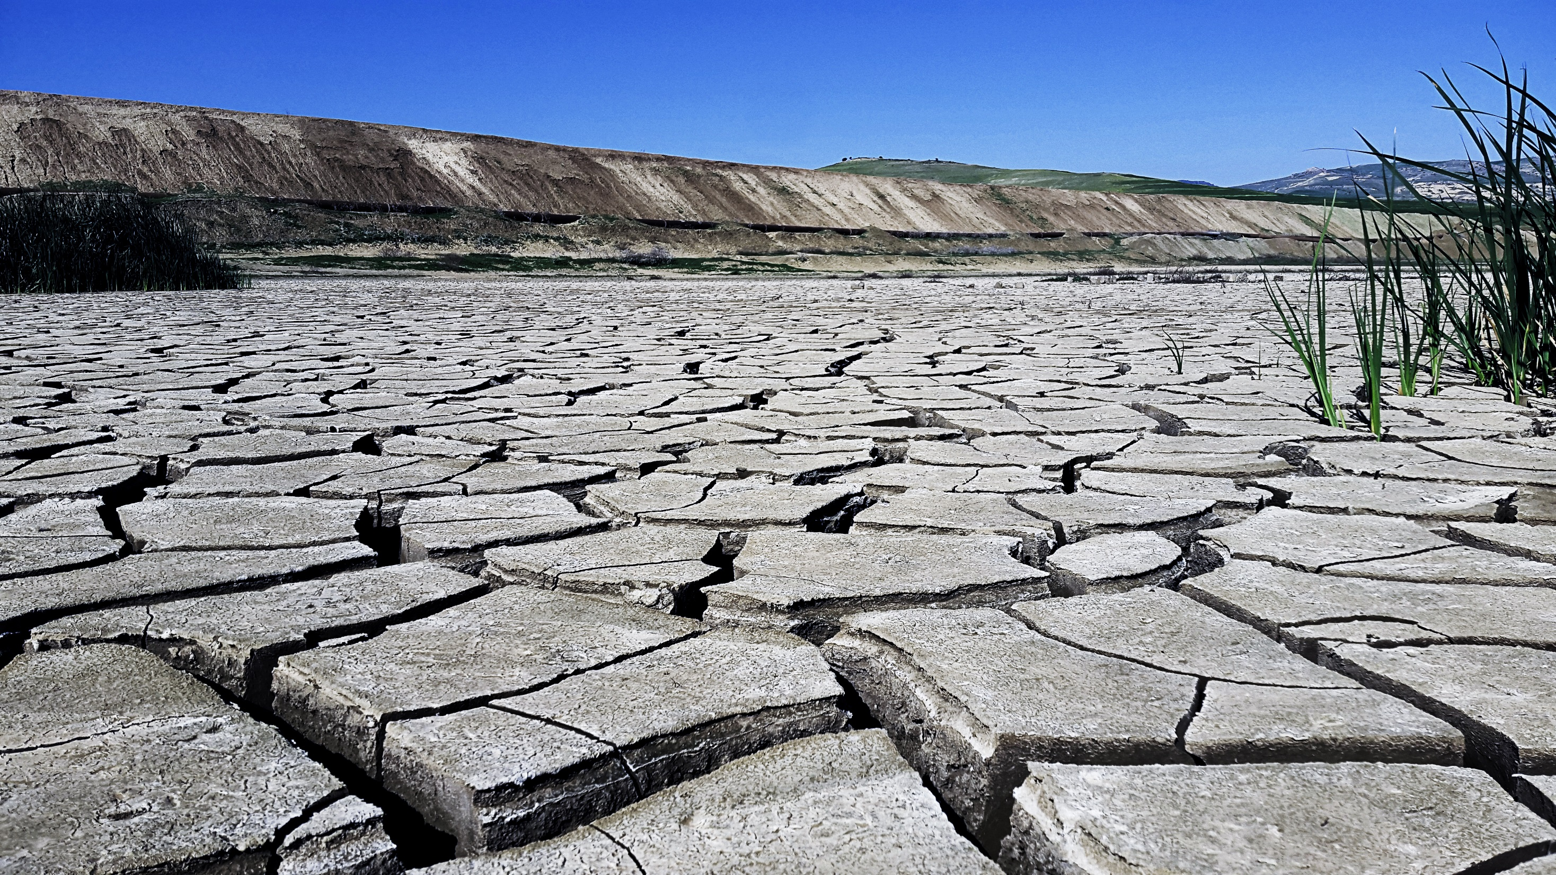

Agricultural Drought Insurance
Marcel Andriesse, Senior Underwriter Agriculture EMEA

Slide 2
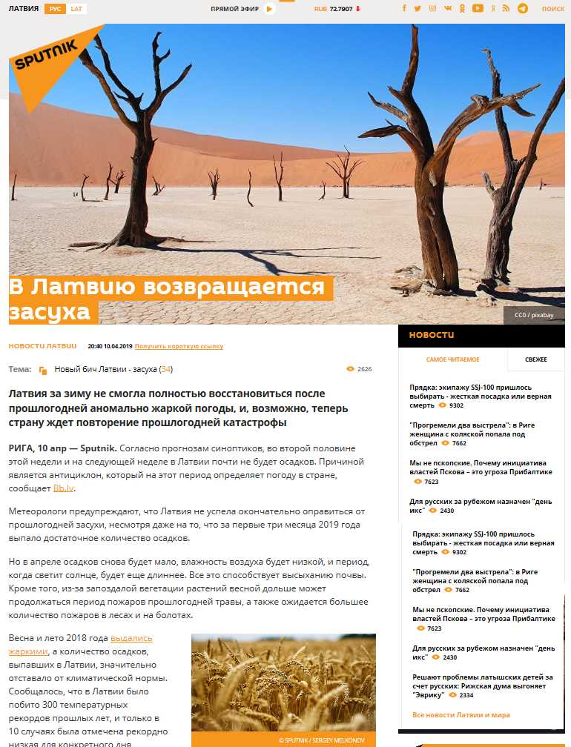
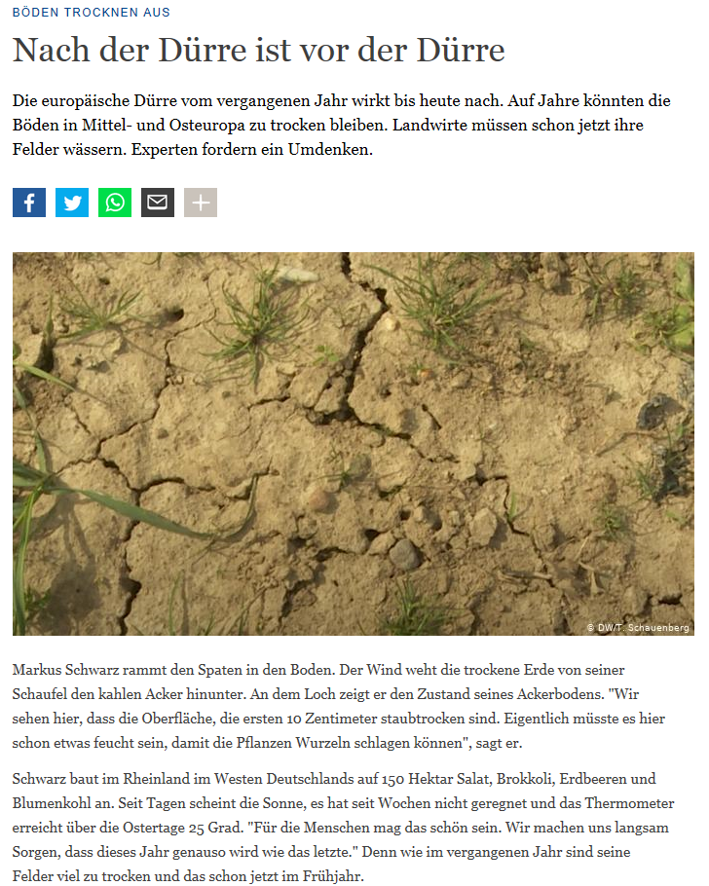
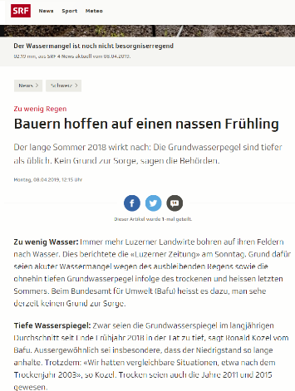
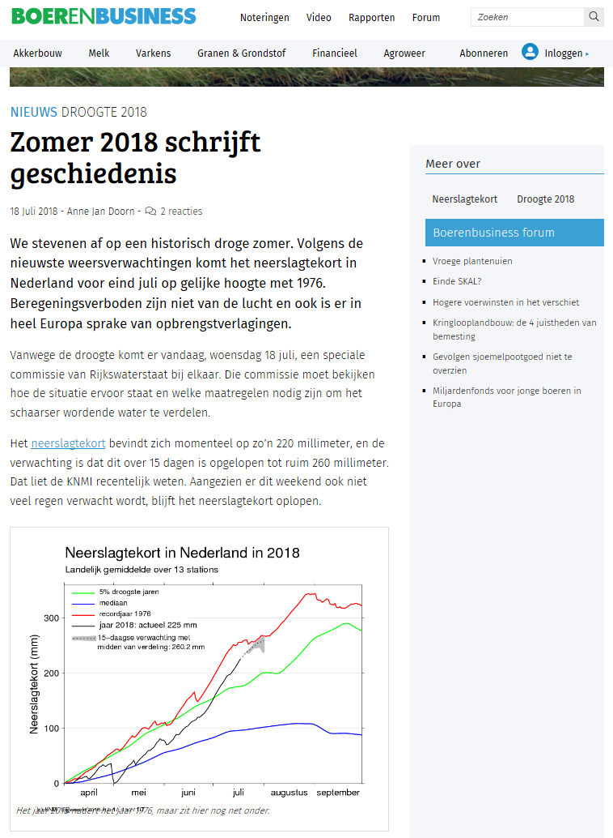
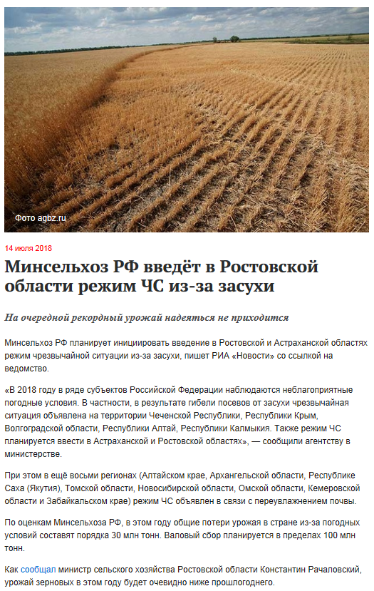
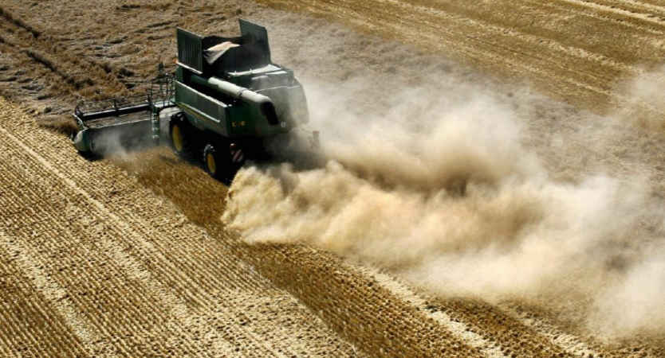
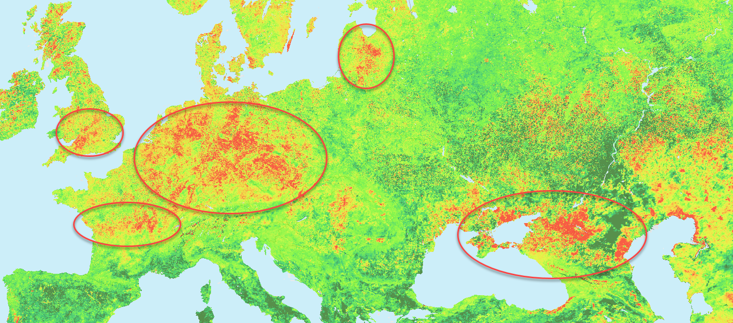
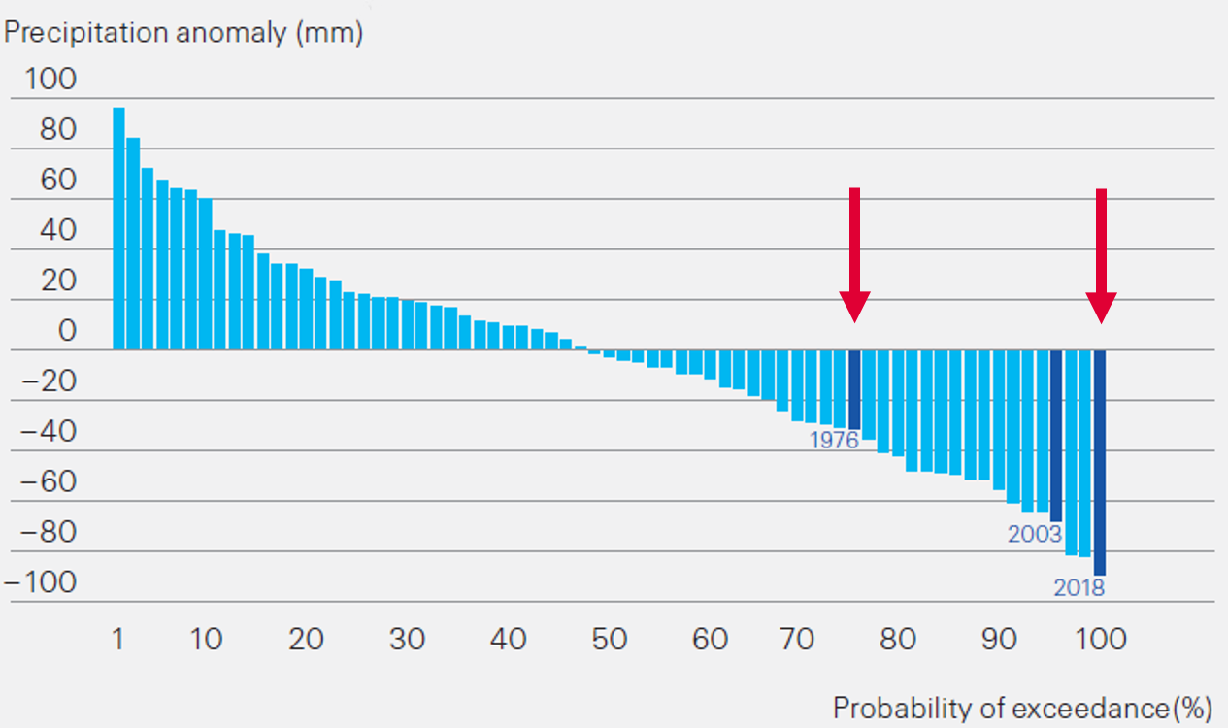
Drought is globally the #1 threat to farmers endangering crops and business
Farmers point of view
Increased frequency and severity of drought events
Drought regularly endangers the crop yield and business of the farmers
Drought is often not covered by insurance, blocking access to credit
  Summer 2018

Slide 3

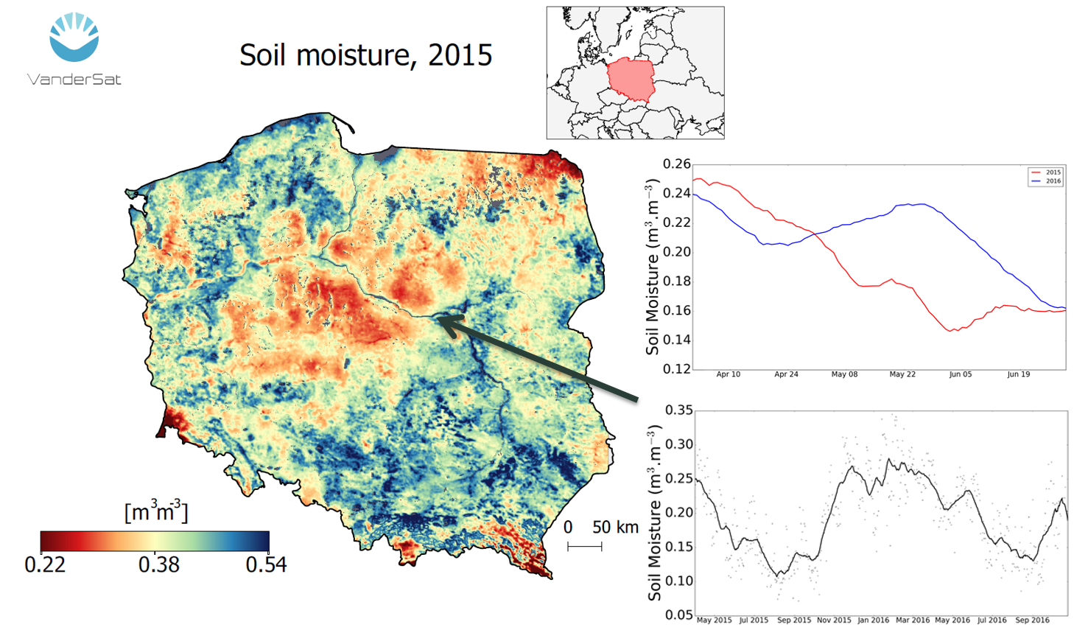
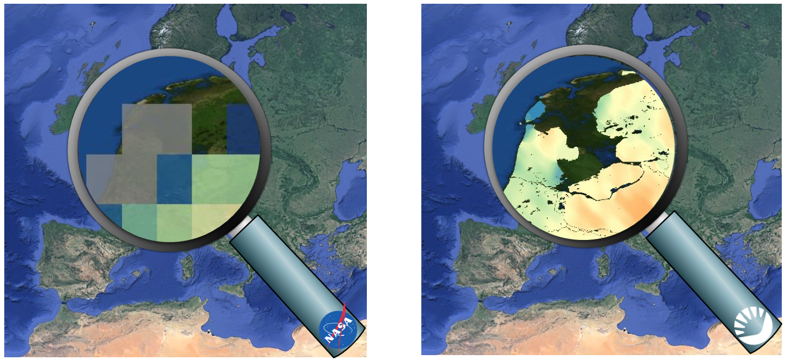
Our Drought Index Solution bringing protection & transparency for farmers and insurers
Insurance Challenge
Our Solution
Impact on You
Difficult to objectively assess losses
No scalable solutions
Lack of trust of farmers and governments
Satellite based Soil moisture index
In cooperation with VanderSat:
  Global data
  100m x 100m
  Real time
  Daily
Transparent , Scalable product
Reduced operational costs
Fully digital insurance processes
  VanderSat Soil Moisture
Passive microwaves

Slide 4
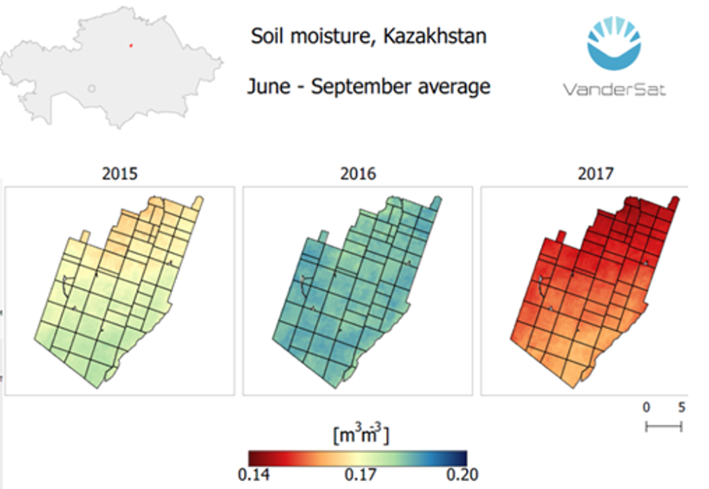
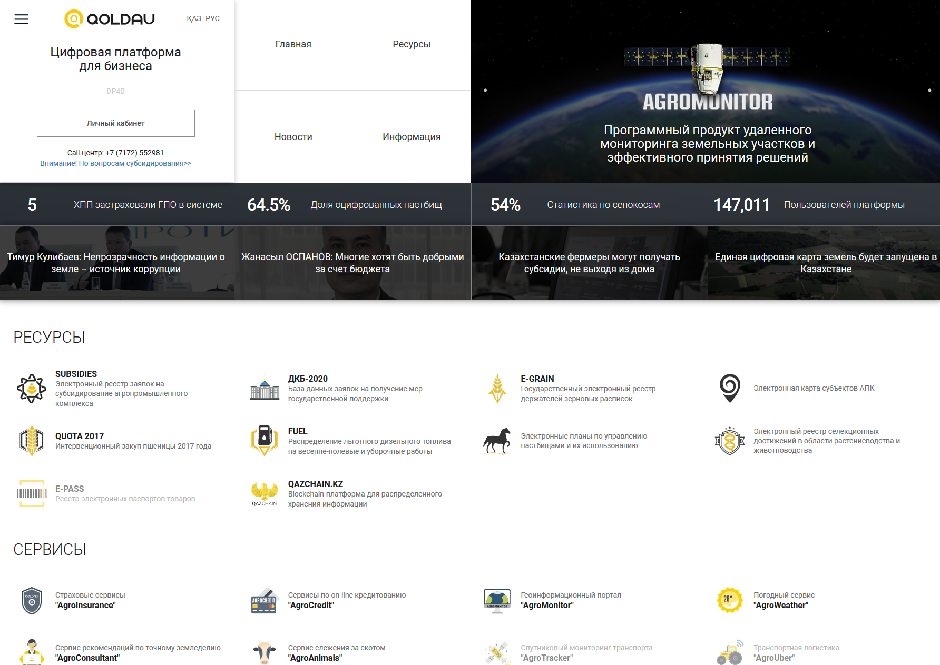
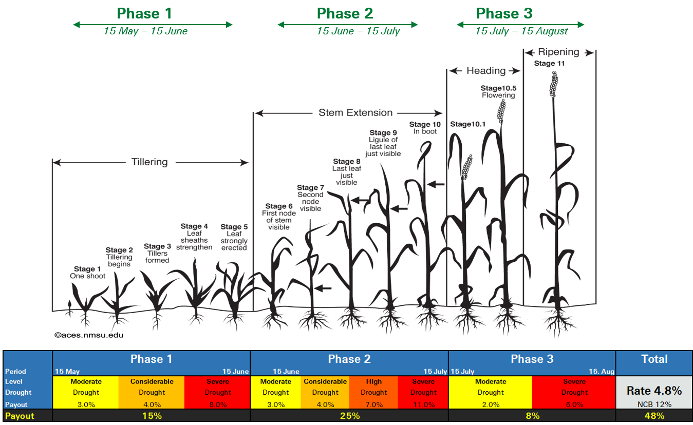
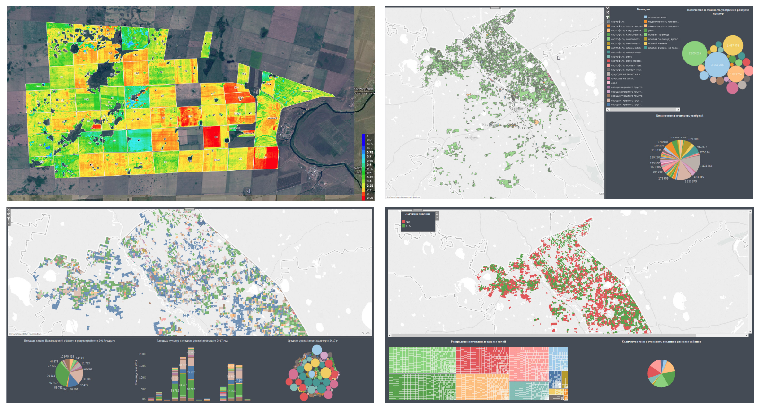
Case study Kazakhstan
Ministry Agriculture
Qoldau Platform
Soil Moisture Index
Wide government support for Agricultural sector in Kazakhstan
Operational challenges with existing claims subsidy insurance scheme
Digital Kazakhstan 2020
Ministry Platform (G2C & B2C)
150’000 farmers registered
100% of fields digitized
Block chain payments
Cooperation with Airbus, DTN, Swiss Re and VanderSat
Pilot project 2018
Country wide roll out 2019
Premium subsidies
Transparent and scalable product
  Kazakhstan Soil Moisture Index

Slide 6
Legal notice
©2019 Swiss Re. All rights reserved. You are not permitted to create any modifications
or derivative works of this presentation or to use it for commercial or other public purposes
without the prior written permission of Swiss Re.
The information and opinions contained in the presentation are provided as at the date of
the presentation and are subject to change without notice. Although the information used
was taken from reliable sources, Swiss Re does not accept any responsibility for the accuracy
or comprehensiveness of the details given. All liability for the accuracy and completeness
thereof or for any damage or loss resulting from the use of the information contained in this
presentation is expressly excluded. Under no circumstances shall Swiss Re or its Group
companies be liable for any financial or consequential loss relating to this presentation.

