Slide 1
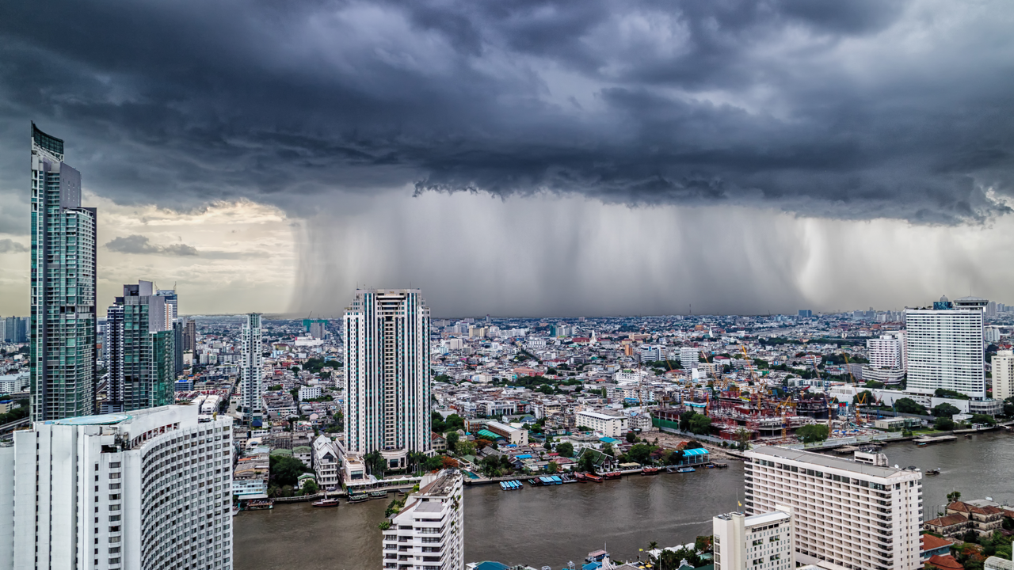

Catserver API - Solutions for Growth
Dr. Angelika Werner, Primary Property Solutions Expert

Slide 2


Our Catserver API solution
Enabling profitable growth through risk transparency
Industry Challenge
Our Solution
Impact on You
substantial unmodelled exposures
underwriting of flood exposure or side perils based mostly on hazard maps
risk evaluation of modelled and unmodelled scenarios unconnected
limited accumulation control
worldwide proprietary model suite
API connection to “Catserver” for client’s underwriting systems
rate return within seconds
multi-locations enabled
portfolio specific and location specific expected loss
provision of PMLs
already numerous products launched
enhanced UW price accuracy
improved risk selection
differentiate with higher limits and/or more competitive prices for side perils
reach new customer base with new products
improved portfolio quality and enhanced transparency

Slide 3
Our global proprietary model suite
Unique coverage accessible through Catserver API
Full probabilistic models for all key perils
Full probabilistic model for key peril, simplified models for side perils
Simplified models for relevant perils

Slide 4







Our API Solution – how does it work
Example of a scoring workflow
API Inputs
Location
Building coverage
Content coverage
Occupancy
Number of stories
Basement info
First Floor elevation
…
1
API data transferred from Client Frontend to Catserver API
Catserver API
Premium Output
Consumer Premium
Storm Surge: $30
River Flood: $15
Windstorm: €20
Client loadings applied to derive customer premiums
Technical Premium adjustment for building specifics
Swiss Re Modelling results
4
3
3
Client side
Swiss Re

Slide 5

Our Value Proposition
Support across the entire value chain
Experienced team at the ready
Comprehensive Rating Solution
Education
Catserver API
Ratemaking
Support in filing products with regulatory authorities
Design a customized products
Risk Transparency and Portfolio Optimization
Regulatory
Underwriting
Marketing
Claims
Loss Consultation and Large loss process advisory
Potential customer identification

Slide 7
Legal notice
©2019 Swiss Re. All rights reserved. You are not permitted to create any modifications
or derivative works of this presentation or to use it for commercial or other public purposes
without the prior written permission of Swiss Re.
The information and opinions contained in the presentation are provided as at the date of
the presentation and are subject to change without notice. Although the information used
was taken from reliable sources, Swiss Re does not accept any responsibility for the accuracy
or comprehensiveness of the details given. All liability for the accuracy and completeness
thereof or for any damage or loss resulting from the use of the information contained in this
presentation is expressly excluded. Under no circumstances shall Swiss Re or its Group
companies be liable for any financial or consequential loss relating to this presentation.

