Slide 1


Old challenges, new solutions
Pavel Huerta Uribe, Senior Property Treaty Underwriter

Slide 2
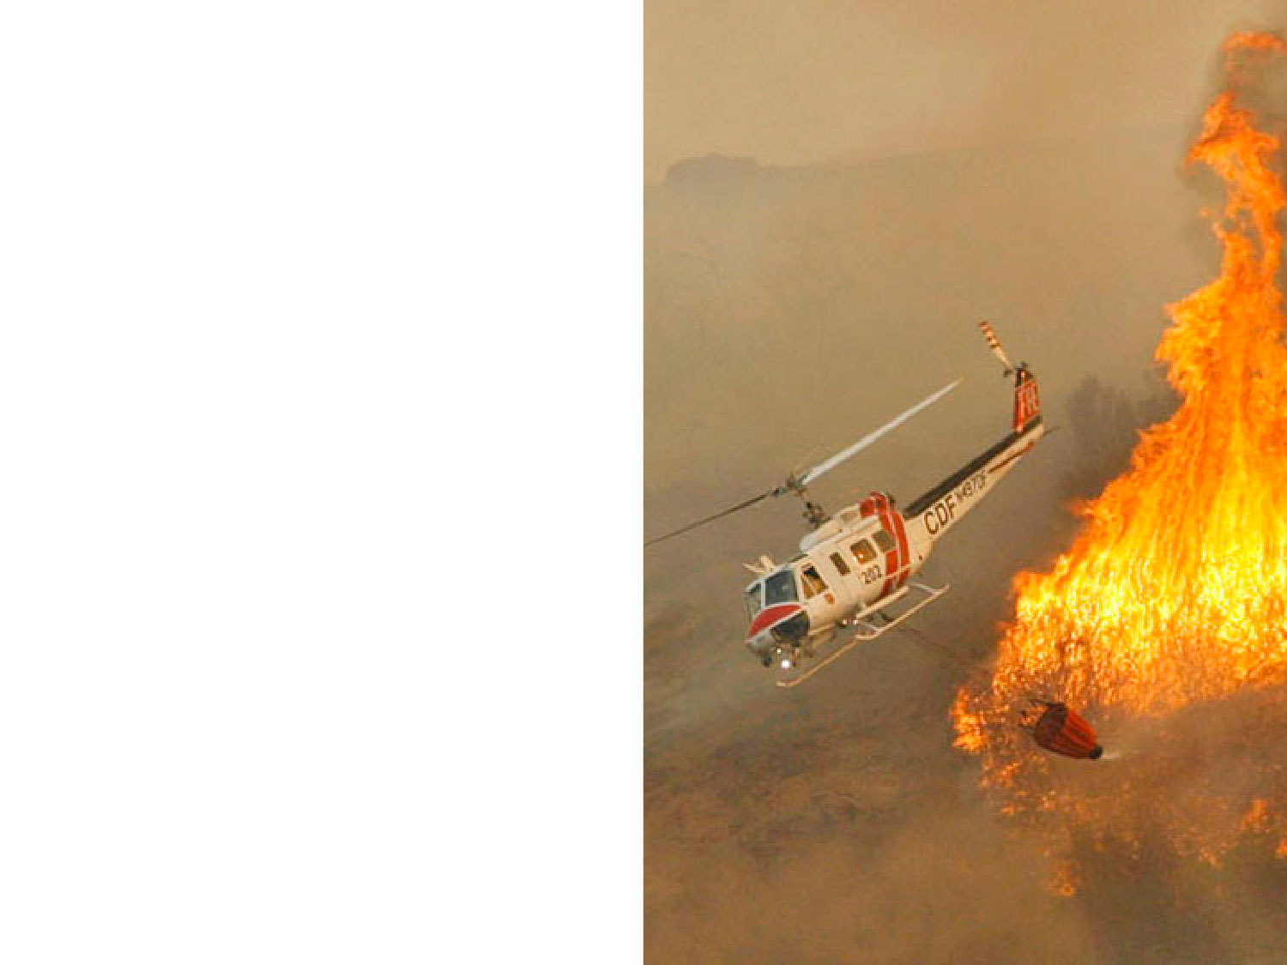


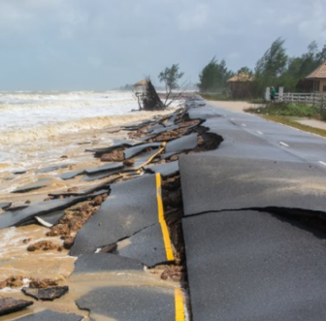


Economic USD loss: 8.9bn
Insured USD loss: 3.9bn
57% uninsured
Storms
EUROPE & AFRICA:
USD 18.5 bn economic losses in 2018
Economic USD loss: 0.3bn
Insured USD loss: 0.1bn
74% uninsured
Wildfires
73%
uninsured
Economic USD loss: 7.3bn
Insured USD loss: 0.3bn
96% uninsured
Drought
Notes:
left: key goal and why and playing grounds
Right: What we do (build new business) and why (to increase the market)

Slide 3

Getting closer to the consumers’ needs
Strategic Partners
Partner with cross industry players
Co-create new value propositions
Integral part of Swiss Re solutions offering
Originate
Build ecosystem of complementing partners
Co-develop
Clear value add to consumer
Scale
Consumers
Get in touch with the end-consumer
Analyze critical consumer situations and contexts
Learn about customer problems and needs
Solve problems with bespoke (insurance) products and services
Interact
Interact in highly emotional moments
Understand
Up Sale

Slide 4





Bespoke Solutions
Swiss Re’s capabilities and resources
Ideation and Design
1
Scope Definition
3
Prototyping
Define our collaboration based on your innovation strategy and customers` needs & pains
Set the foundations of our collaboration remuneration
Build a prototype to show the customer and test them over and over again
Findings will be basis for a go-live MVP
2
Design Thinking
4
Product & Business Plan
Define a challenge that we will tackle with human centred design – Design Thinking
We design fully from customer perspective
Plan the MVP development, define the business plan and get resources
Prepare the development of a fully fledged product

Slide 5





Bespoke Solutions
Designing successful propositions together
Development
1
Product Development & Pricing
3
Business Management
Terms & Conditions, policy wording, product structuring, pricing, modelling, benchmarking,
legal topics, regulatory issues,…
Refine and adjust products
Portfolio analysis and Claims’ steering
2
Implementation & Launch
4
Reinsurance
Positioning and marketing support, develop customer journey, define distribution network, develop incentive system for salesforce
Risk sharing on the product co-developed
We have skin in the game

Slide 6





























More than 130 success stories
 | NCP |  |  | NCP
 | MP
 | PCC |  |  | PCC
 | NCP
 | MP
 | NCP
 | MP |  |  | PCC
 | NDC |  |  | NCP
 | PCC
 | MP
 | PCC
 | MP
 | PCC |  |  | PCC
 | NCP
 | NDC |  |  | NCP
 | PCC
 | PCC
 | NCP
 | PCC
 | MP
 | NCP |  |  | PFE
 | PCC |  |  | PCC
 | NCP
 | PFE
 | NCP |  |  | NCP
 | NCP |  |  | NCP
 | MP
 | PCC
 | PCC
 | MP
 | PFE |  |  | PCC
 | MP
 | MP |  |  | PFE
 | NCP |  |  | NCP
 | PFE
 | NCP
 | NCP
 | NCP
 | NDC
 | PFE |  |  | NCP
 | PCC
Legend
MP: Mortgage protection
PCC: Parametric complementary covers
NDC: New distribution channels
PFE: Protection for the financially excluded
NCP: Traditional nat cat product

Slide 8
Legal notice
©2019 Swiss Re. All rights reserved. You are not permitted to create any modifications
or derivative works of this presentation or to use it for commercial or other public purposes
without the prior written permission of Swiss Re.
The information and opinions contained in the presentation are provided as at the date of
the presentation and are subject to change without notice. Although the information used
was taken from reliable sources, Swiss Re does not accept any responsibility for the accuracy
or comprehensiveness of the details given. All liability for the accuracy and completeness
thereof or for any damage or loss resulting from the use of the information contained in this
presentation is expressly excluded. Under no circumstances shall Swiss Re or its Group
companies be liable for any financial or consequential loss relating to this presentation.

